Slide 1
Backpropagation and Gradient Descent in Neural Networks
Krzysztof Buzar
Data Science Retreat May 2024

Slide 2
About me
Software Engineer at DIEHL Controls/Metering
Background in academia:
Biotechnology
Bioinformatics
Computational theoretical biophysics
Benchmarking enjoyer

Slide 3
Agenda
Intro to deep learning
DL in the machine learning project-cycle
What is DL and why should we use it?
Neural networks
Perceptrons
The feedforward pass
Backpropagation
Activation functions
Stochastic gradient descent
Our goal: build a image classifier for digits, first in Numpy, then in PyTorch

Slide 4
Knowing the jargon
Model aka network aka architecture (although a fine-grained distinction exists here with respect to training)
Weight aka parameter aka connection strength Hyperparameter
Capacity
Loss aka cost aka error function Error rate aka 1 - accuracy Sensitivity aka recall
Activation function Transfer learning Epoch vs Batch
Convolution, receptive field Linear aka “Dense” layer

Slide 5
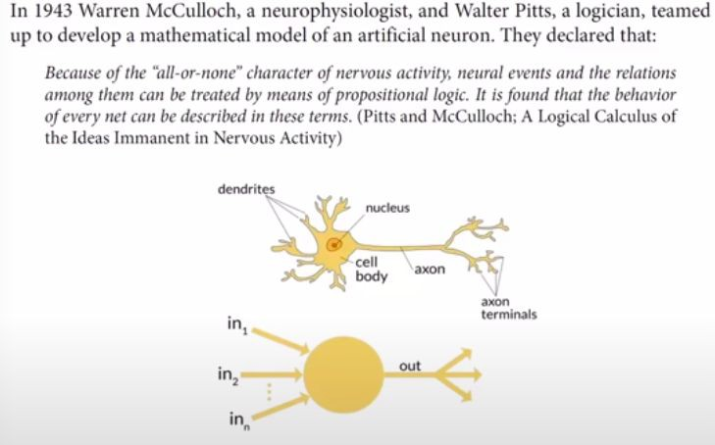
What is an artificial neural network?
Artificial “neurons” are also called “processing units”
Recommended read: “The Man Who Tried to Redeem the World with Logic”

Slide 6
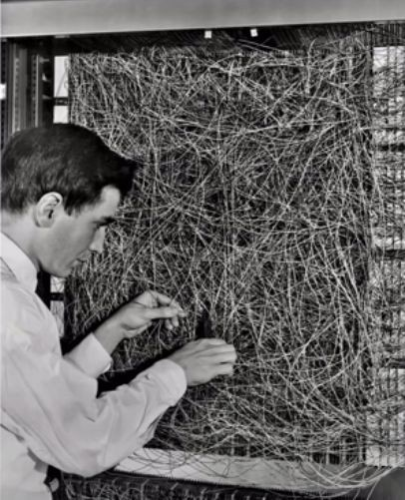
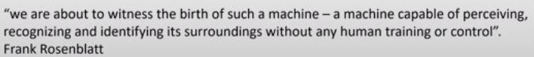
What is an artificial neural network?
Image: Frank Rosenblatt with the Mark I Perceptron at Cornell University (1961)

Slide 7
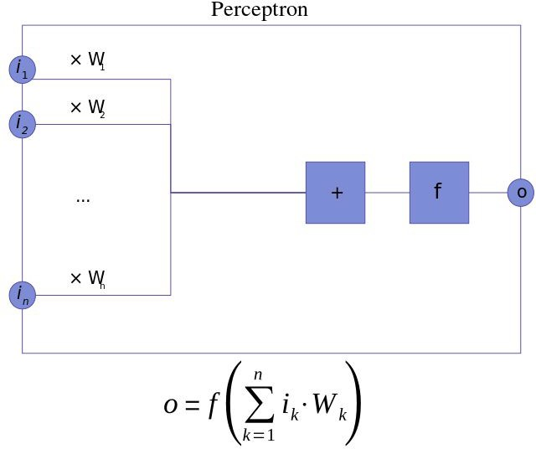
What is a perceptron?

Slide 8
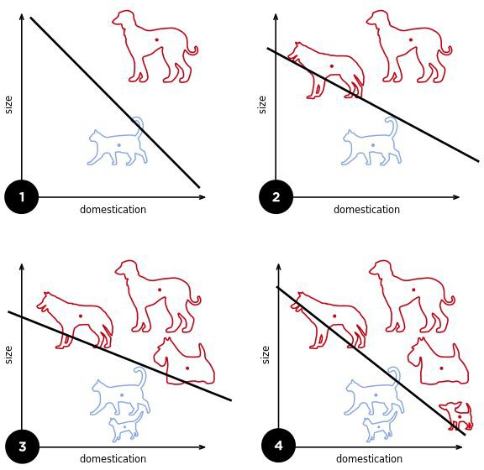
What is a perceptron?
A fine-grained discussion about the differences in logistic regression and the perceptron algorithm

Slide 9
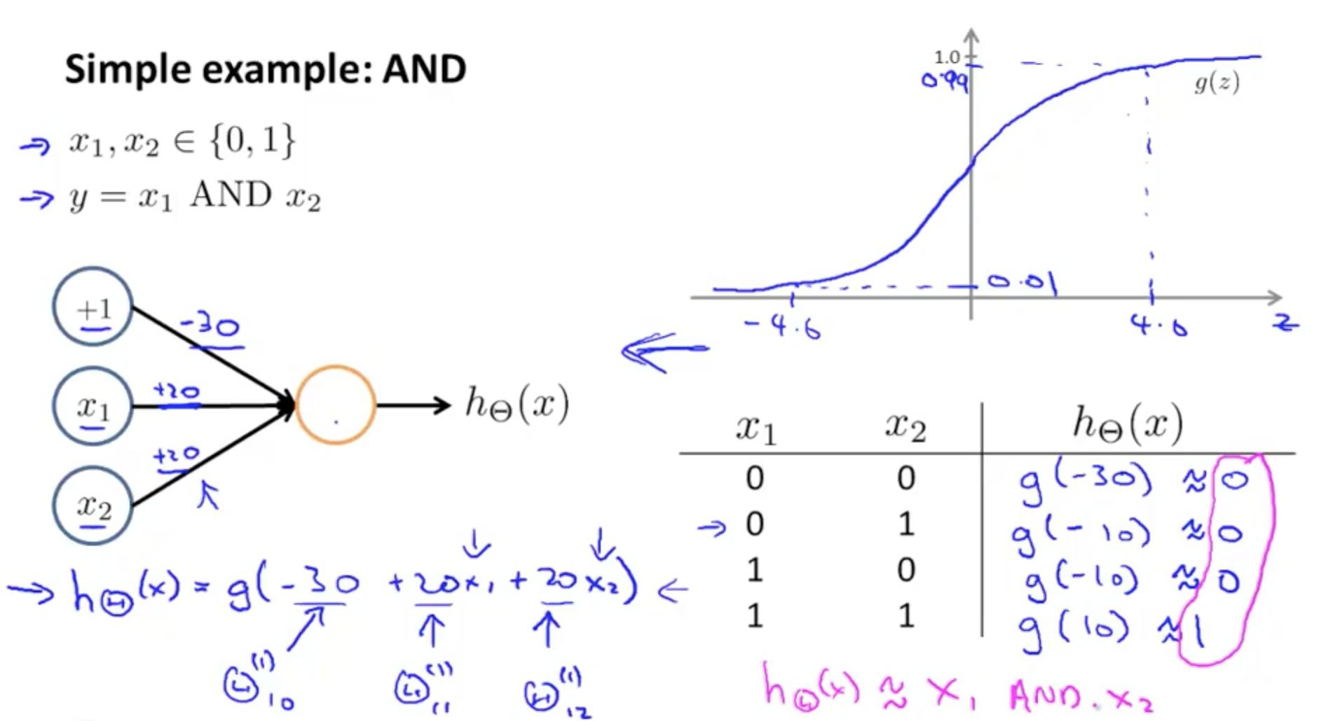
What does a neural network ‘learn’?
It learns “weights” aka “parameters” aka “connection strengths” that minimize a measure of error (aka “loss” aka “cost”) function given a set of training inputs x (aka “a dataset”)

Slide 10
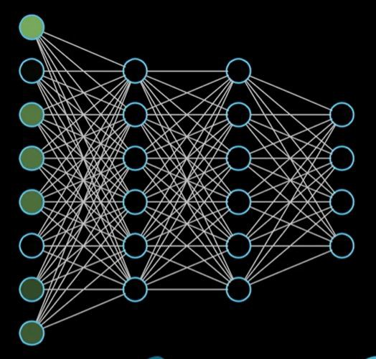
Multilayer perceptrons

Slide 11
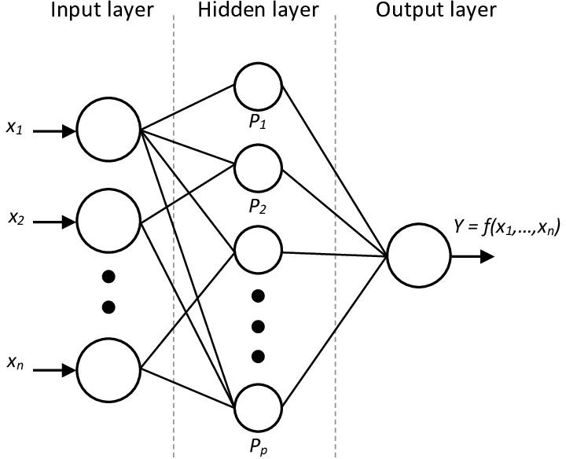
Hidden layers

Slide 12
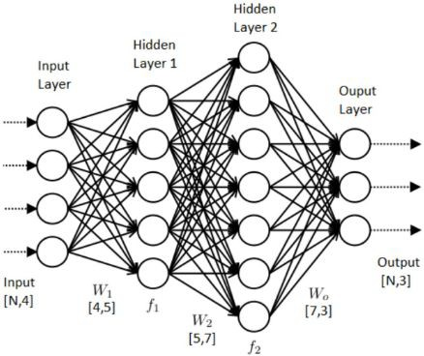
Hidden layers

Slide 13

Stir the pile

Slide 14
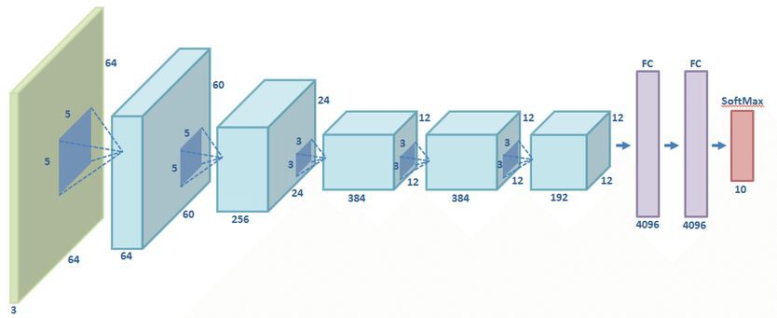
Different network architectures represent different ways to ‘stir the pile’
Architecture of the Alexnet network

Slide 15
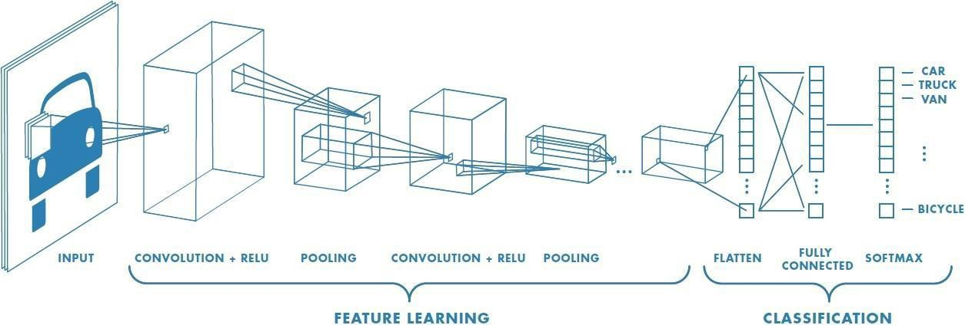
What is deep learning?

Slide 16
Visualizing a CNN
Convolutional Neural Network Visualization by Otavio Good

Slide 17
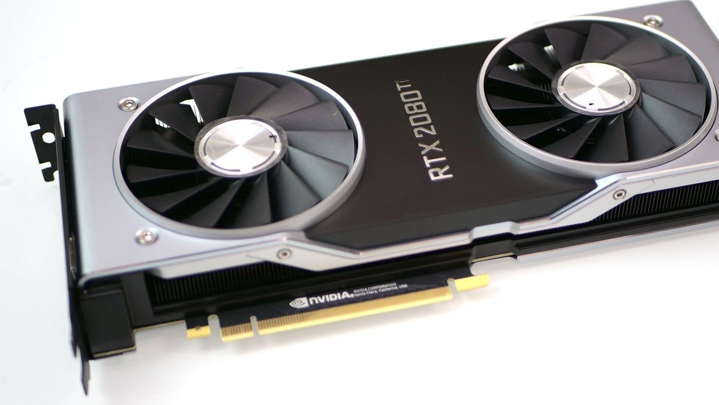
What is a GPU?
Most deep learning libraries require the use of NVIDIA graphical processing units with CUDA capabilities

Slide 18
Why use a GPU for deep learning?
How is a CPU different from a GPU?
More cores!
Why are CPUs less effective for deep learning?
Less cores :(

Slide 19
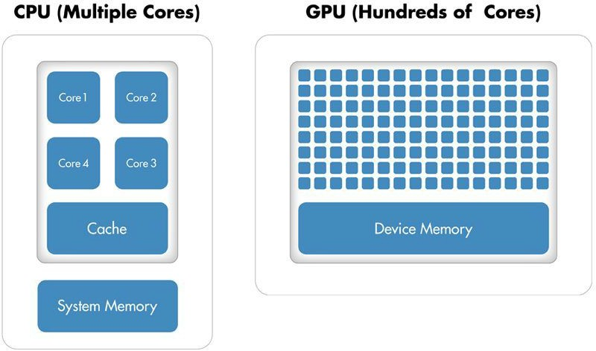

Slide 20
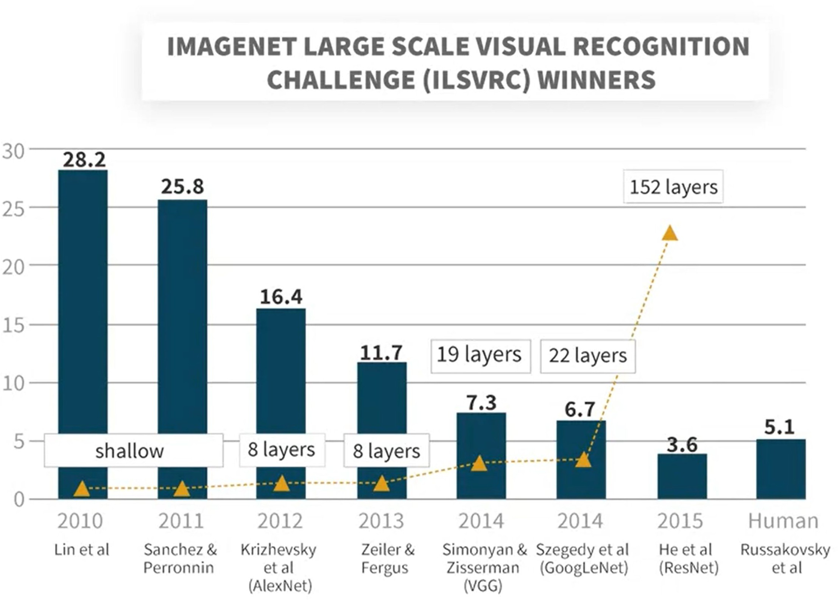

Slide 21
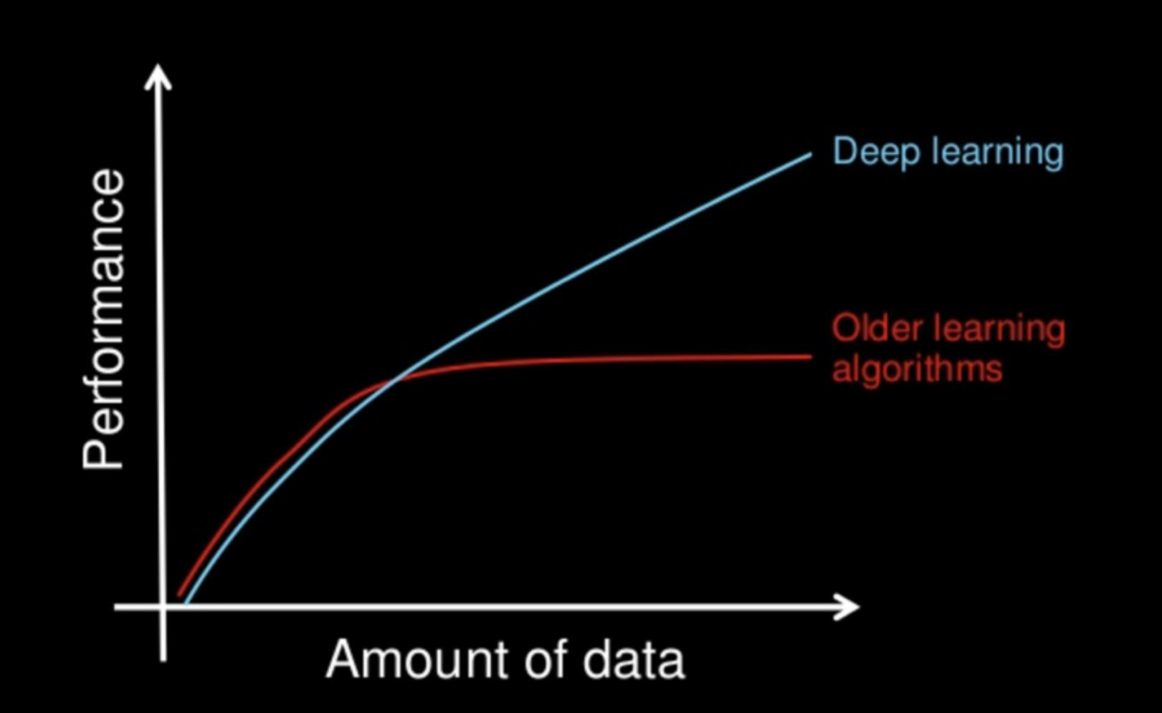
Why do we use deep learning?
Disclaimer: the No Free Lunch Theorems explain why this graph might be hype, although things like the current GPT experiments show promise

Slide 22
Applications of deep learning
Computer vision: image classification, object detection, segmentation, image description, image generation, satellite and drone image analysis
Natural Language Processing: translation, text and DNA sequence prediction, text generation
Audio understanding, audio generation, lip reading
Playing games, finding optimal strategies (when paired with reinforcement learning)
Any system that requires the finding of significant correlations or patterns/”intuitions” in the data, i.e. the ‘thinking fast’ systems referred by Daniel Kahneman in his famous book.

Slide 23
Why do we use deep learning?
Deep neural networks are universal function approximators
This means that given the right architecture and training, they can compute everything that’s computable, just like a Universal Turing Machine
In practice this means that deep networks are very good at finding very sophisticated decision boundaries (aka “curve fitting”)
Finding the function means the finding architecture and or training of the neural network
It’s fair to call deep neural networks “linear regression on steroids”
Deep neural networks pick hidden correlations in the data, but most architectures don’t pick on causality (current research topic)

Slide 24
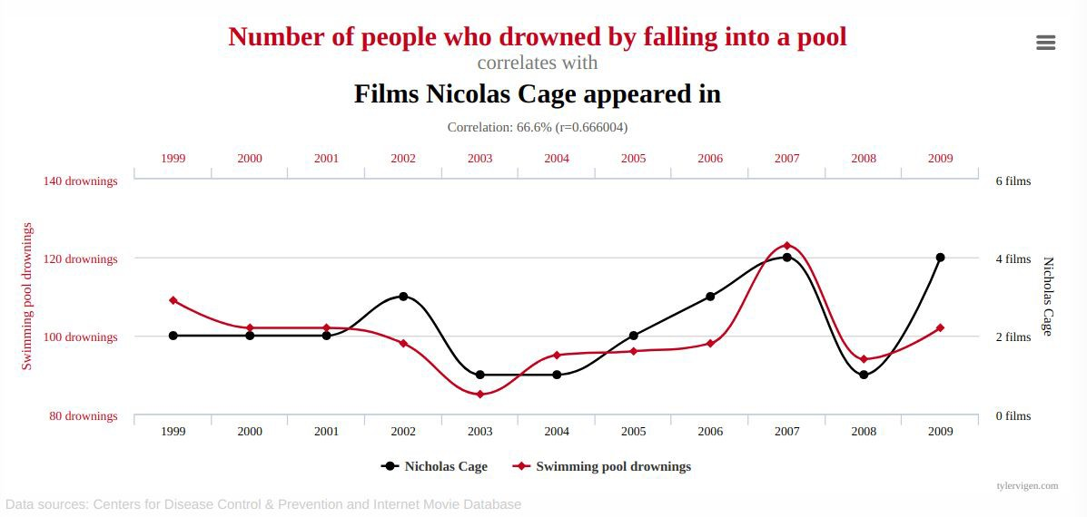

Slide 25
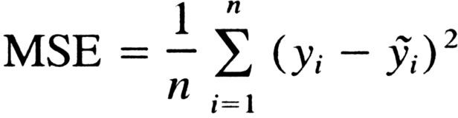
Choose the right loss function for the task
Mean Squared Error is a loss function for regression

Slide 26
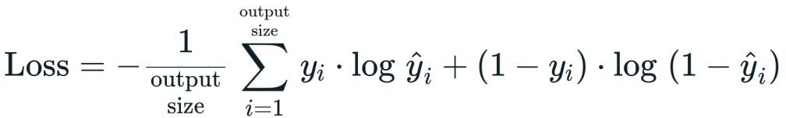
Choose the right loss function for the task
Cross entropy is a function for classification, used interchangeably with negative log-likelihood, here we see it in its binary case

Slide 27
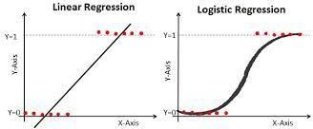

Slide 28
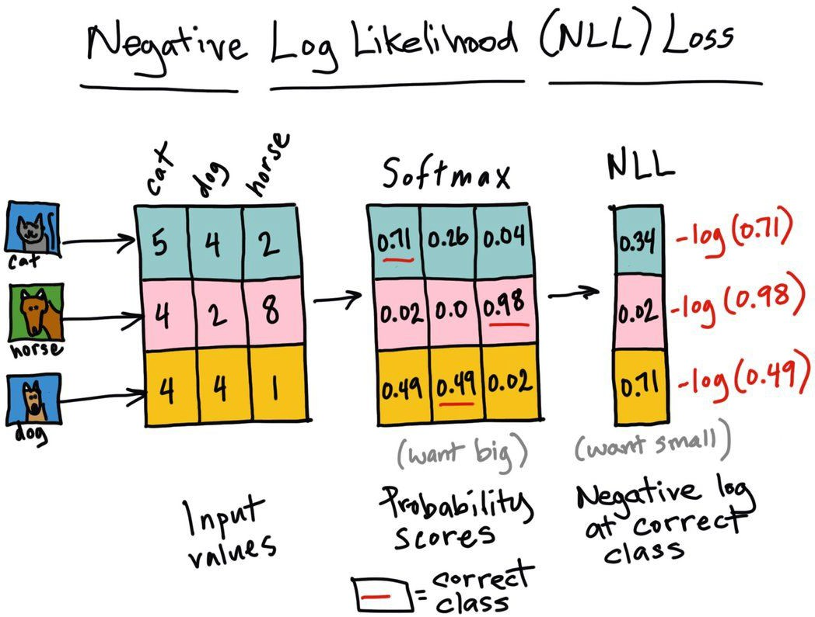
Can we solve this task with logistic regression?

Slide 29
Q: Which loss function should we use for binary logistic regression?
Mean Squared Error
Cross Entropy
Negative log-likelihood (huh? Maybe read this too later.)
Precision & Recall
None of the above

Slide 30
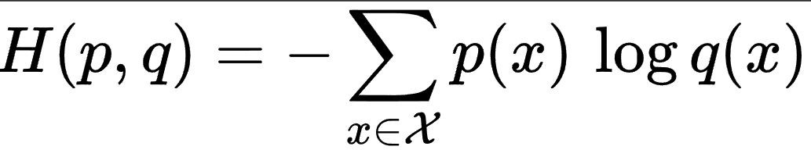
Cross Entropy

Slide 31
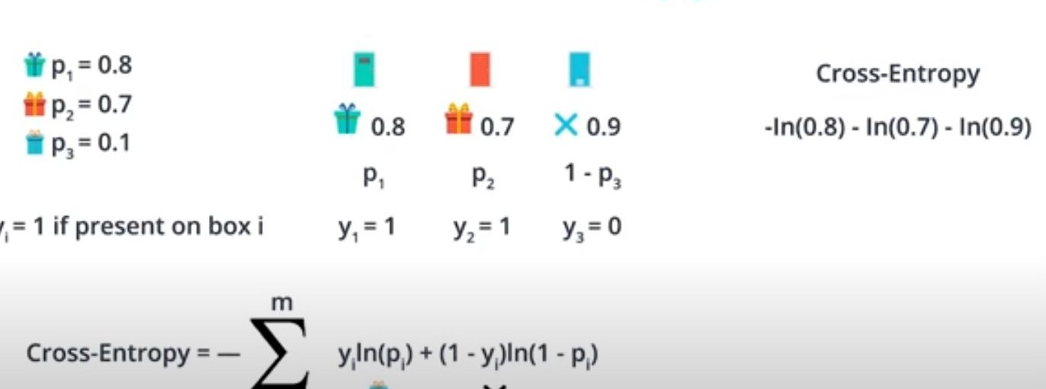
Cross entropy
Explore the Colab notebook

Slide 32
Exercise Solution
Refer to this tutorial and this discussion

Slide 33
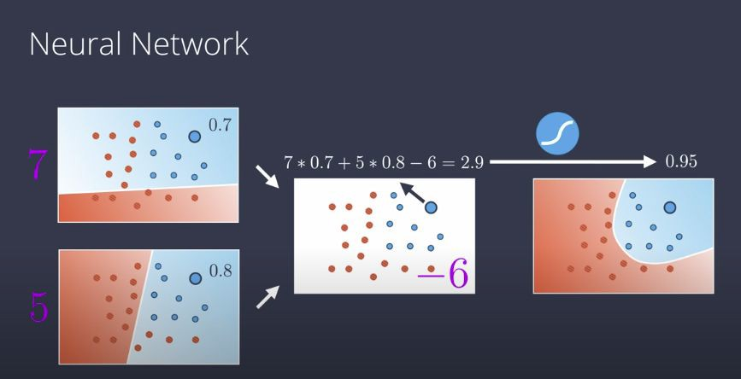

Slide 34
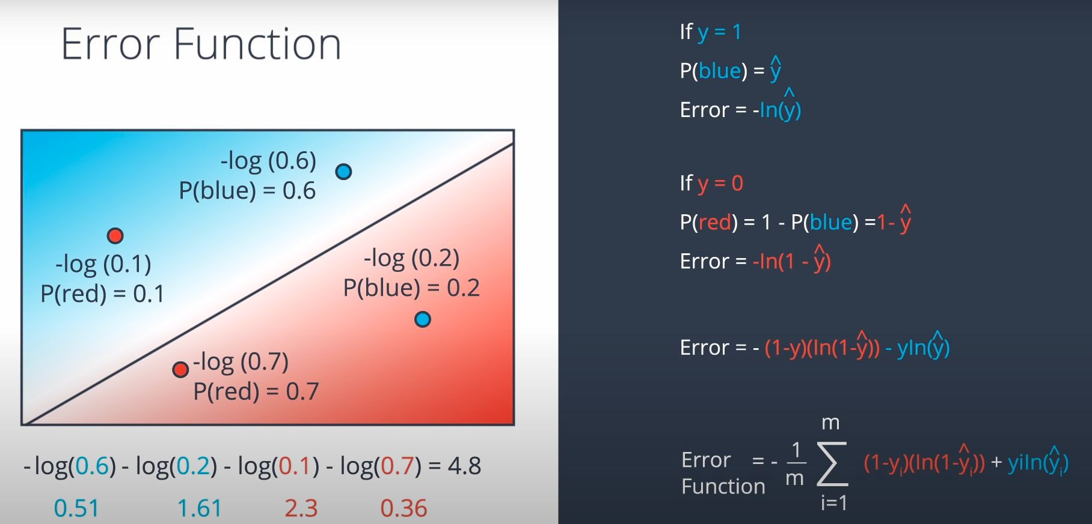
The loss function
Q: Which of these points have higher cross entropy?

Slide 35
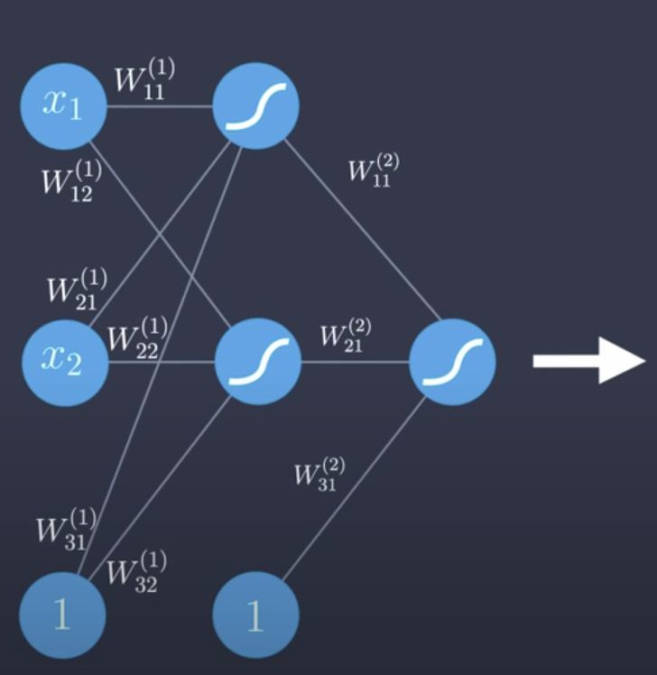
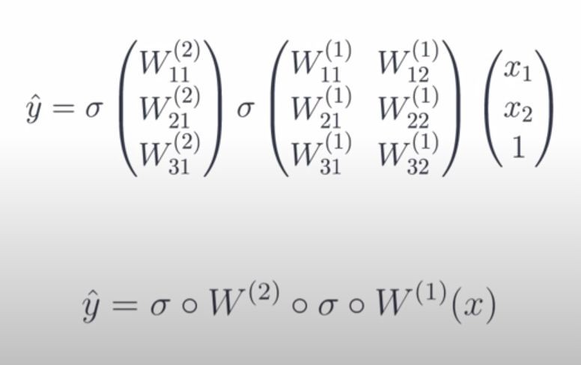
The feedforward pass
Understanding the feedforward pass

Slide 36
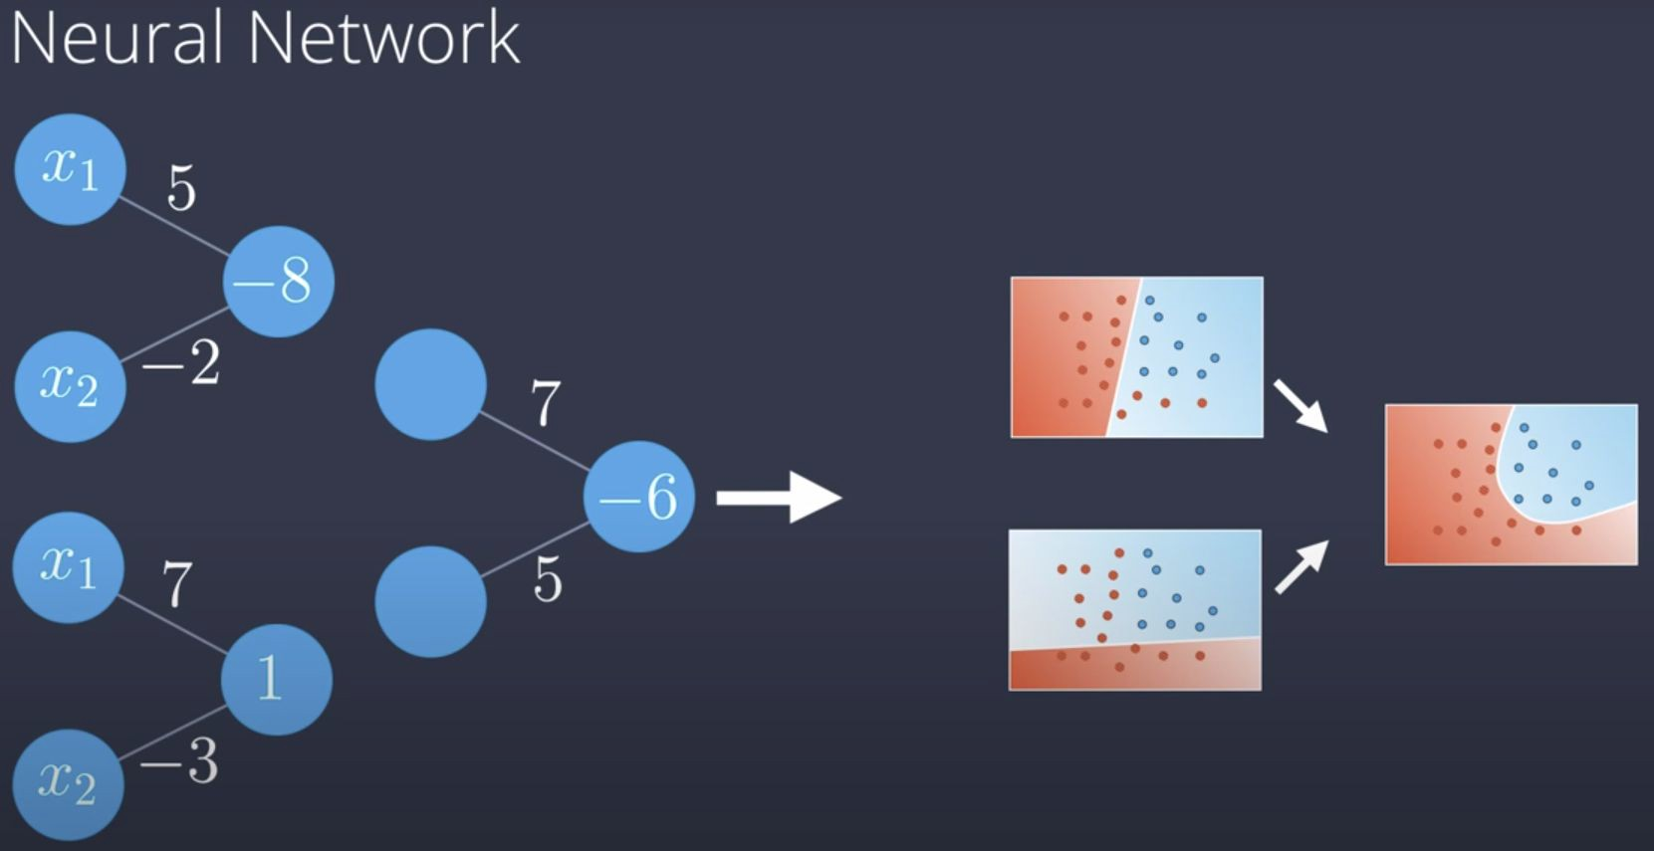
Learning non-linearities
How neural networks learn non-linearities

Slide 37
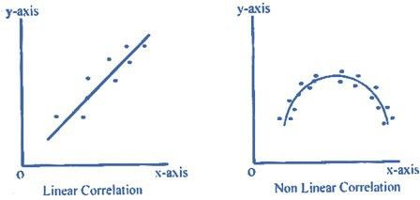
Learning non-linearities
How neural networks learn non-linearities

Slide 38
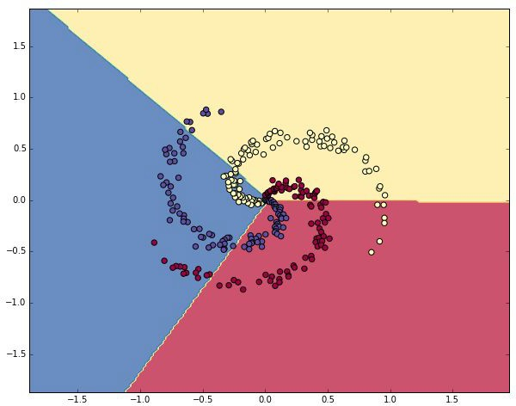
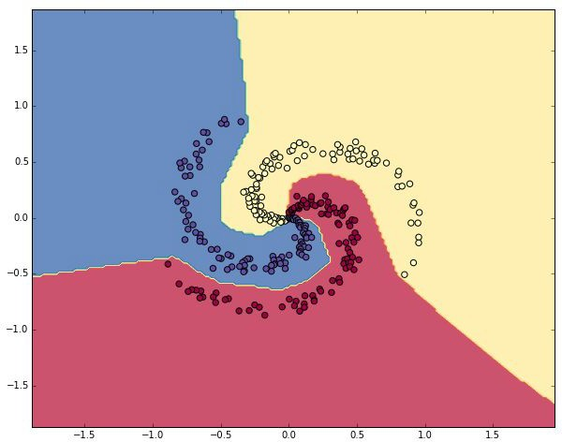
Learning non-linearities
https://cs231n.github.io/neural-networks-case-study
Experiment notebook
Q: What happens with large learning rates? What happens with large coefficients for l2 regularization?

Slide 39
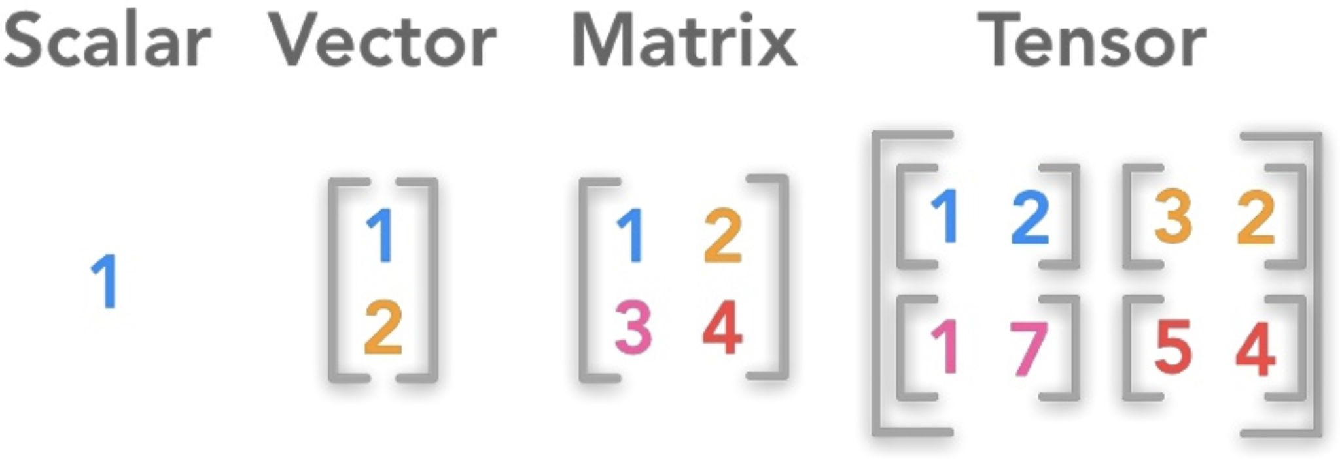
Read: scalars, vectors, matrices, and tensors
Understanding rank terminology

Slide 40
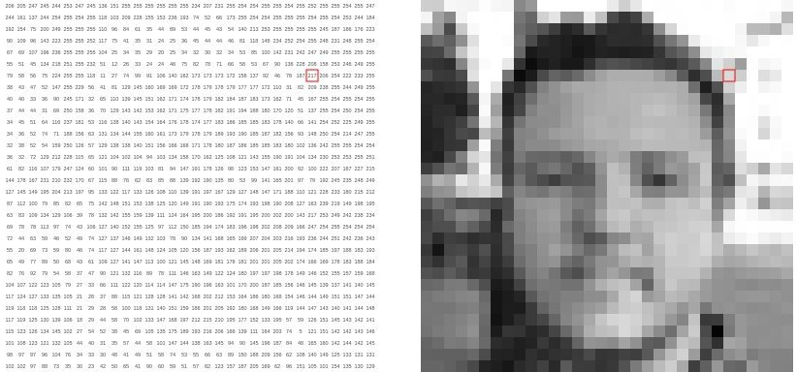
How do computers represent images?
https://setosa.io/ev/image-kernels/

Slide 41
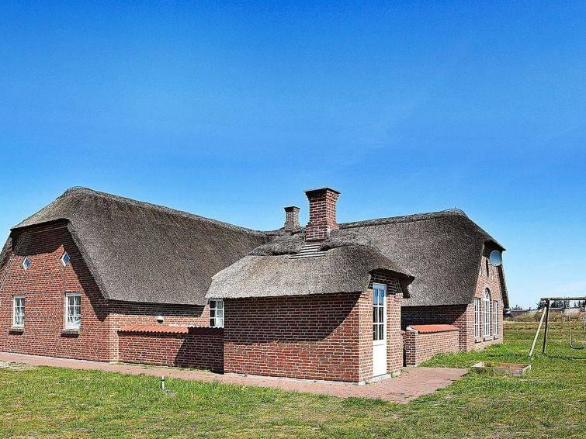
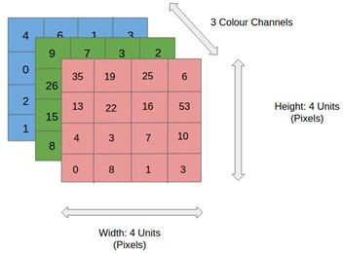
Images as tensors
What a human sees
What the computer ‘sees’

Slide 42
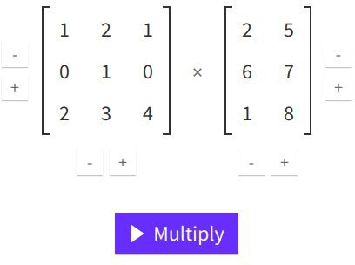
Matrix multiplication
http://matrixmultiplication.xyz/

Slide 43
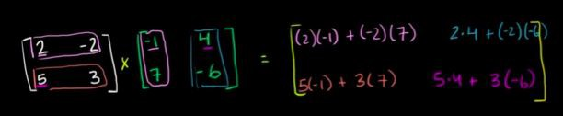
Matrix multiplication
Khan Academy Tutorial

Slide 44
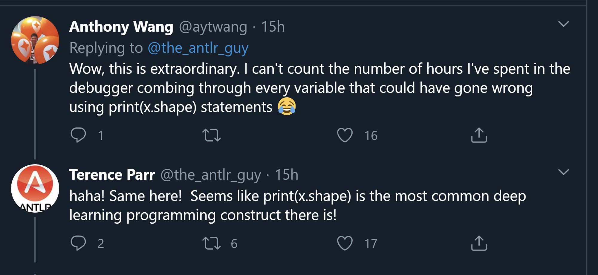
Pay attention to the size of the input

Slide 45
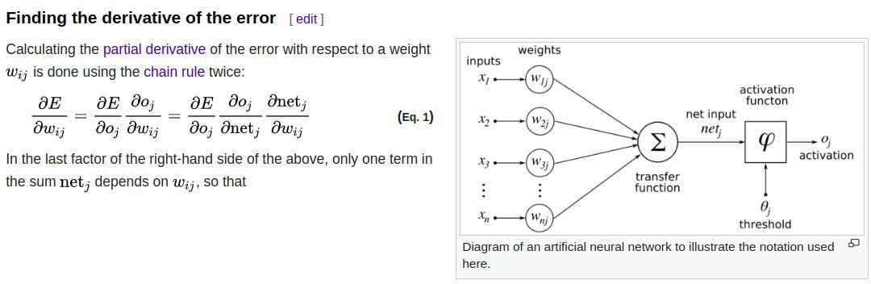
Backpropagation
https://en.wikipedia.org/wiki/Backpropagation

Slide 46
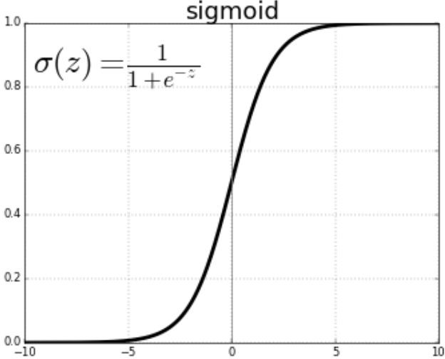
The sigmoid activation function

Slide 47
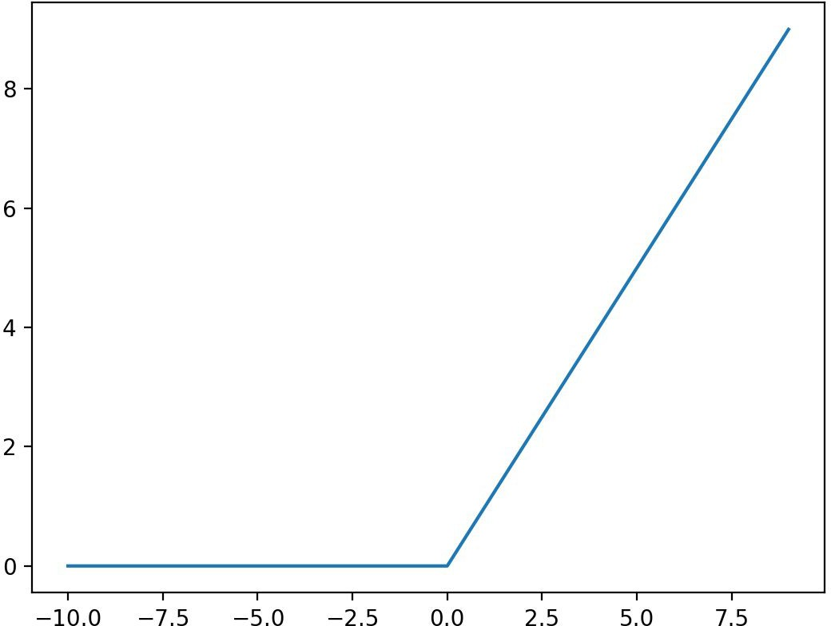

The rectifier linear unit (ReLU) activation function

Slide 48
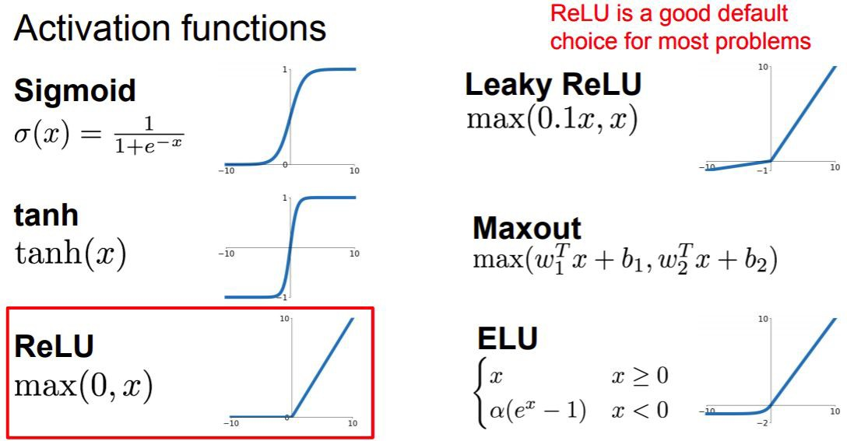
http://cs231n.stanford.edu/slides/2019/cs231n_2019_lecture04.pdf

Slide 49
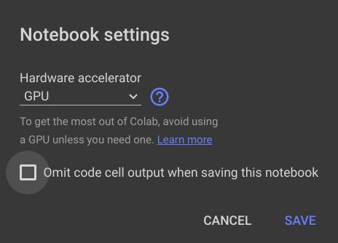
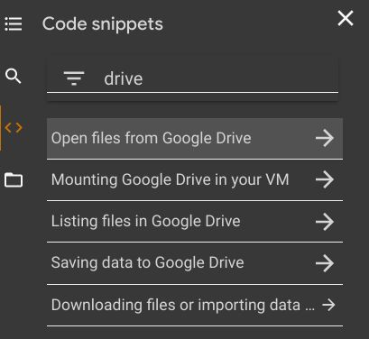
Setting up Google Colab

Slide 50
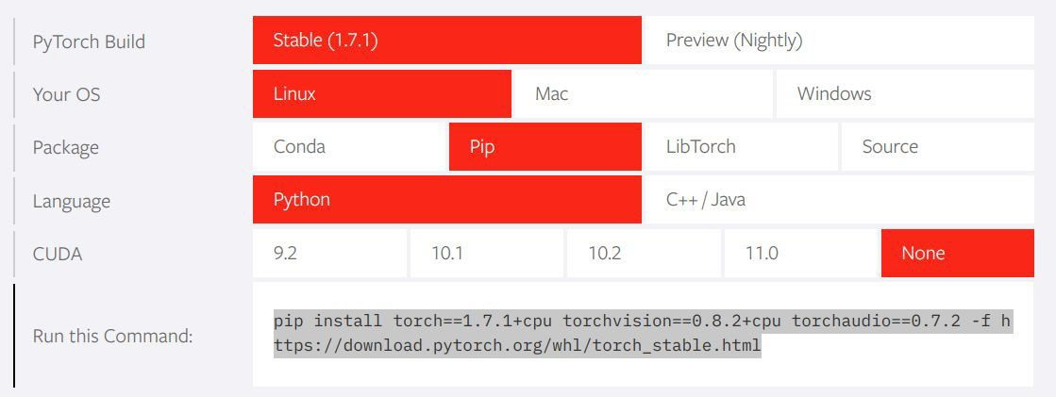
Installing PyTorch
https://pytorch.org/

Slide 51
Practice: tensors in Pytorch
Notebook
Solutions
Questions:
Why do we use bias terms?
How is a torch tensor different from a numpy array?
Is a torch tensor always run on a GPU?
What is an in-place operation? How are in-place methods named in Pytorch?
Is the rectifier linear unit a linear or a non-linear function?

Slide 52
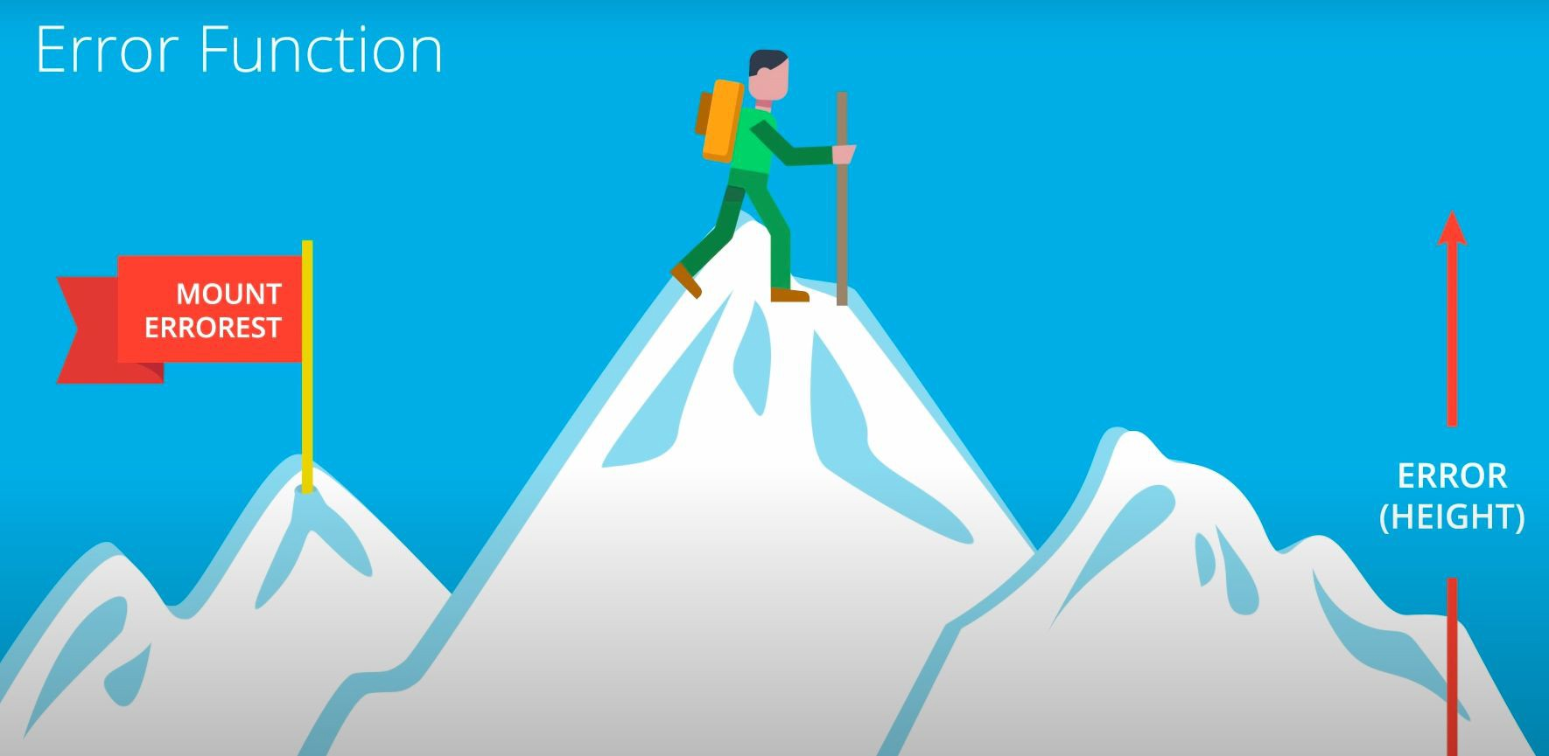
Gradient descent
https://github.com/fastai/fastbook/blob/master/04_mnist_basics.ipynb

Slide 53
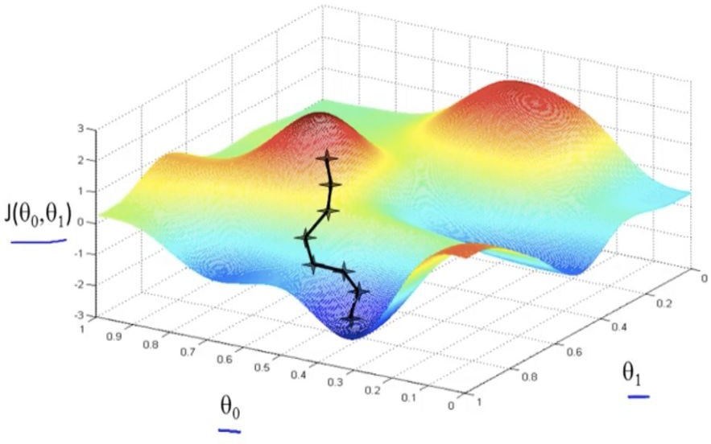
Stochastic gradient descent

Slide 54
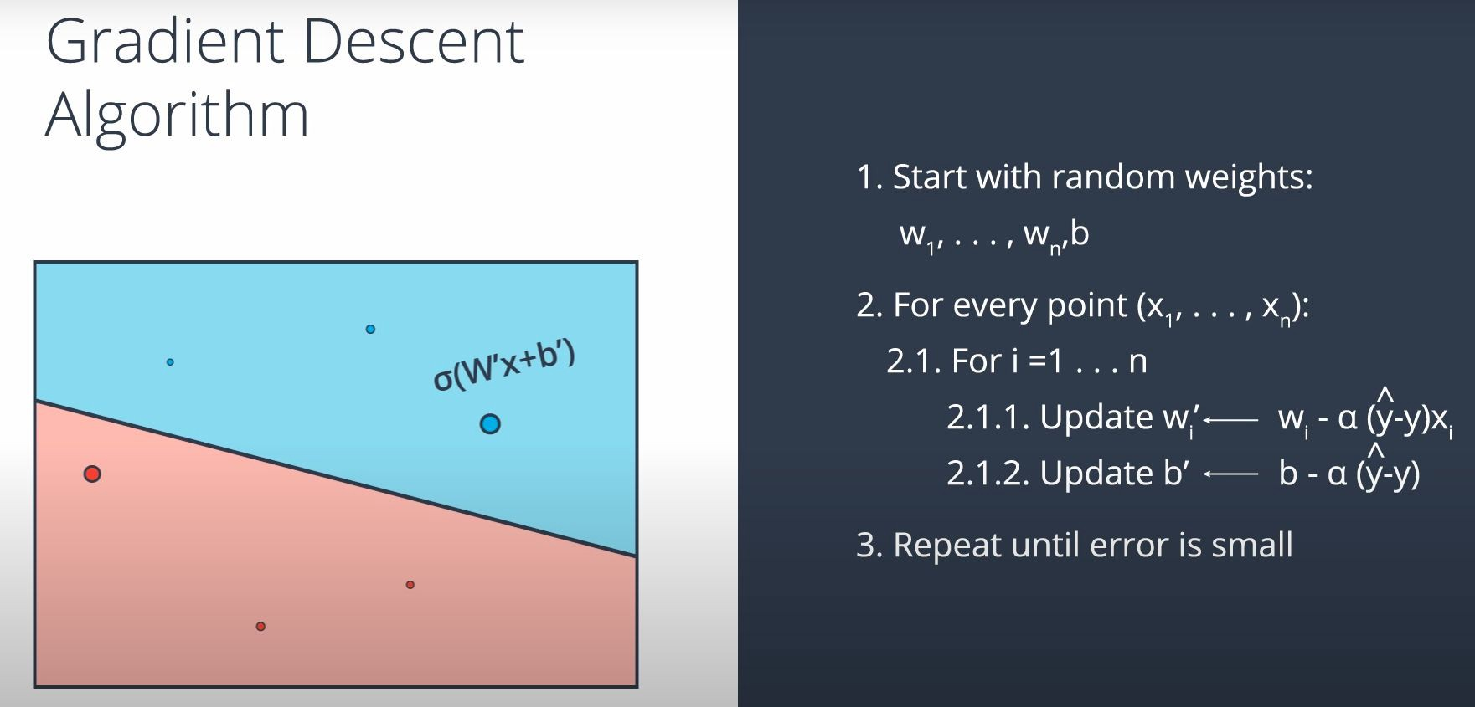
Implementing gradient descent

Slide 55
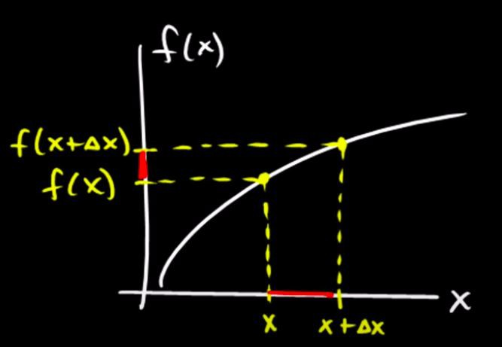
Numerical calculation of derivatives
Numerical derivatives
Numerical and analytic derivatives in Python

Slide 56
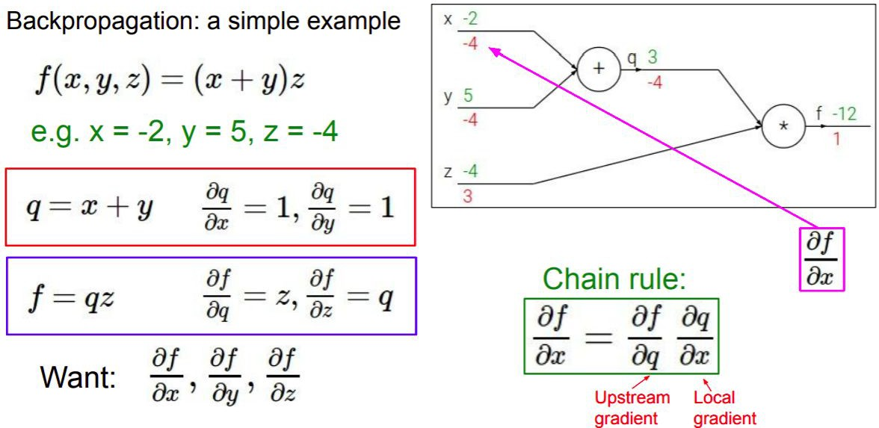
Gradient computation graphs
http://cs231n.stanford.edu/slides/2019/cs231n_2019_lecture04.pdf

Slide 57
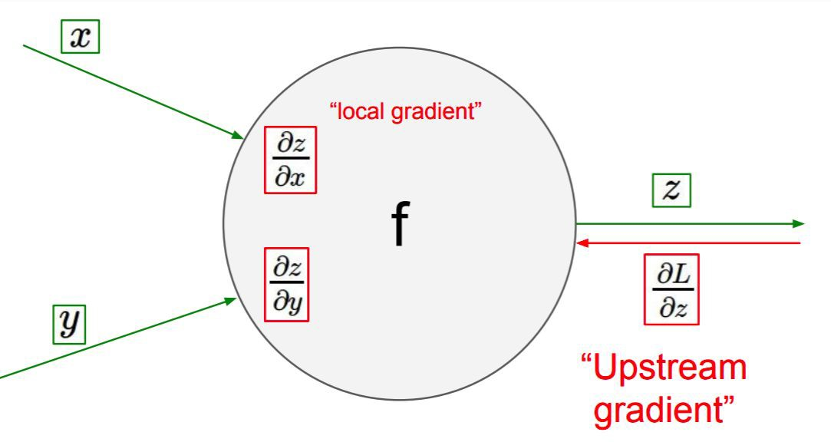
Gradient computation graphs
http://cs231n.stanford.edu/slides/2019/cs231n_2019_lecture04.pdf

Slide 58


Slide 59

The importance of the learning rate

Slide 60

The importance of the learning rate

Slide 61

Choosing a learning rate

Slide 62


Choosing a learning rate

Slide 63

Weight decay aka lx-regularization
L1 and L2 regularization

Slide 64

The bias vs variance tradeoff

Slide 65

The bias vs variance tradeoff

Slide 66

The bias vs variance tradeoff

Slide 67
Practice: neural networks in PyTorch
Notebook
Solutions
Questions
How do we subclass nn.Module?
What is a subclass?
How many layers do we need to learn non-linear mappings?
What is the purpose of a dataloader?
What is nn.Linear?
What is the purpose of nn.Sequential?
Why would we use OrderedDict to define an architecture?

Slide 68

The Softmax function
https://en.wikipedia.org/wiki/Softmax_function
The softmax activation function in Python

Slide 69
Practice: training in PyTorch
Notebook
Solutions
Questions:
What is a logit (in the context of neural networks)?
How do we turn logits into probabilities?
What criterion should we use if we change nn.LogSoftmax to Softmax? (Read this discussion)
Where do we define the size of the batch?

Slide 70
Performance metrics vs loss functions
A model performance metric measures the quality of predictions in the validation or test sets. Accuracy, precision, recall, specificity, fbeta, f1, and ROC are performance metrics, not loss functions
The default classification error metric in fastai is error_rate = 1 - accuracy
The loss function is used to adjust the weights of the model (through its gradient). The error metric is a report of performance and it can be opposite to the loss function

Slide 71

Understanding the bias vs variance tradeoff in neural network architectures

Slide 72

How long should we train the network?
Until it overfits! (Training loss goes down while validation loss goes up)
This general principle applies to all hyperparameters related to model complexity

Slide 73

The intuition of momentum
Exploring momentum’s beta (notebook)

Slide 74

Understanding momentum

Slide 75

The ADAM optimizer
Exponentially moving averages and used to smoothen the trajectory of the gradient descent. Averages are computed across training batches. This optimization algorithm usually trains faster than SGD

Slide 76
Practice: classifying images with fully connected networks
Notebook
Solutions
Questions:
How is the image fed into the network?
Why shouldn’t we use the network’s accuracy as a Pytorch criterion?
What is the optimizer?
How does ADAM differ from Stochastic Gradient Descent? How are they similar?
What is the lr parameter that we pass to the optimizer?
Why do we pass model.parameters() to the optimizer?

Slide 77
Review questions
What is a loss function? Is the f1 measure a loss function or a performance metric?
Explain what the ReLU activation function does in one sentence.
Can we use accuracy as a loss function? Can we use precision or recall as loss functions?
Is the accuracy guaranteed to increase as the value of the loss function goes down?
Which parts of the model need to be differentiable for an architecture to be trainable?
What are we trying to minimize when using gradient descent? What is the learning rate?
What is a GPU? Why are GPUs useful for deep learning?

Slide 78
Review questions
What is an epoch? What is a batch? What is the maximum size of a batch? How does the batch size influence training?
What is the difference between stochastic gradient descent (SGD) and ‘vanilla’ AKA ‘regular’ gradient descent?
What is momentum? What is the difference between ADAM and SGD?
What is a Jacobian? What is a Hessian? Do we use Hessians in deep learning?
Suppose that we have a ground truth for a ‘cat’ label that is encoded as [0, 1]. We can assume that the ground truth for a ‘dog’ label is [1, 0] (cat is the training point).
The network first outputs [0.75, 0.25] as prediction
In the next epoch it outputs [0.99, 0.01] as prediction
Has the cross entropy loss increased or decreased?

Slide 79
Review questions
What does it mean for a dataset to be ‘linearly separable’?
How many layers does a neural network need in order to learn non-linear correlations?
What’s the difference between a performance metric and a loss function?
Why should we shuffle the data in every training epoch?
Explain the bias vs variance tradeoff.
Effect of increasing the number of training epochs
Increasing the number of layers
Increasing the amount of dropped out connections
How would you define ‘regularization’?
What is the purpose of dropout? How does it work? Should dropout be active during inference time?

Slide 80
Review questions
What is the vanishing gradient problem?
What does it mean to “transfer a tensor” to the GPU?
What is CUDA?
How does the amount of RAM available in the GPU affect the types of models and data that we can use to train?
What should we try when torch reports ‘CUDA out of memory’ errors?

Slide 81
Review questions
Why do we need to call
What’s the difference between a parameter and a hyperparameter? What’s another common name for ‘parameter’ in a neural network?
How can we know what’s the “optimal” number of units in a hidden layer?
How can we know the “optimal” number of layers in a network?
Is data augmentation a regularization technique? Why should we apply data augmentations probabilistically?
Why should we shuffle the data inside a training batch?
If a model is increasing its loss through several epochs should we increase or decrease the learning rate?
How do we evaluate training and validation loss to do early stopping?
optimizer.zero_grad()
in the training loop?

Slide 82
Review questions
What is weight decay? What is learning rate decay?
Suppose that after going through certain number of epochs the training loss is higher than the validation loss. Is this an example of underfitting or overfitting?
What is the vanishing gradient problem? Why does it appear?
Are vanishing gradients more likely to appear when representing Jacobians and weight vectors with 8 bits, 16 bits, or 32 bits of precision?
Why are ReLU activation functions less likely to display vanishing gradients than sigmoid activation functions?

Slide 83
Review questions
Why do we resize images before training?
If we retrain or do inference on a network pre-trained on Imagenet, why do we need to normalize its image channels using the mean and std of the intensities of the original dataset?
What is a receptive field?
What is a convolution?
Why do we apply padding to images before doing convolutions?
When calling conv2d(...,..., 64) how many output channels are we producing? How are they different from each other?
Why is the vanishing gradient a ‘numerical’ problem? What does that mean?
Are we more likely to get vanishing gradients when using fp16 or fp32 data types for our weights?

Slide 84
Resources
Intro to Deep Learning with PyTorch at Udacity
Convolutional Neural Networks at Coursera
Fast.ai - Deep Learning for Coders
PyImageSearch Blog
Stanford’s CS231: Convolutional Neural Networks for Visual Recognition
3blue1brown’s series on neural networks
Goodfellow’s Deep Learning Book (great for theory)
Visualizing and understanding neural networks (Stanford lecture)
Review content on cross entropy
On ML Mastery
Brief video by Udacity
Aurelien Geron’s explanation

Slide 85
Regression with a neural network
https://utstat.toronto.edu/reid/sta2212s/2021/Galton85.pdf
https://www.researchgate.net/publication/280970132_Galton's_Family_Heights_D ata_Revisited

